Slide 1
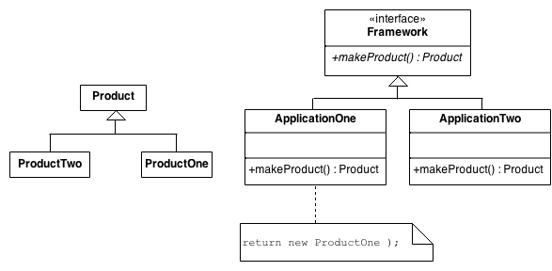

Slide 2
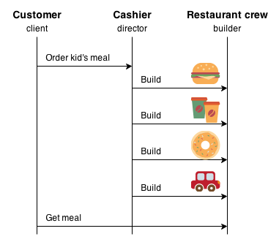
The Builder pattern separates the construction of a complex object from its representation so that the same construction process can create different representations. This pattern is used by fast food restaurants to construct children's meals. Children's meals typically consist of a main item, a side item, a drink, and a toy (e.g., a hamburger, fries, Coke, and toy dinosaur). Note that there can be variation in the content of the children's meal, but the construction process is the same. Whether a customer orders a hamburger, cheeseburger, or chicken, the process is the same. The employee at the counter directs the crew to assemble a main item, side item, and toy. These items are then placed in a bag. The drink is placed in a cup and remains outside of the bag. This same process is used at competing restaurants.

